Slide 1
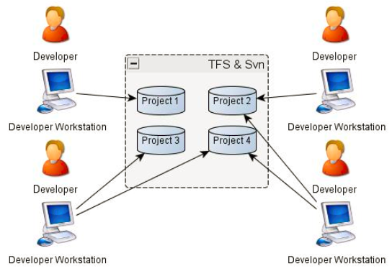
Centralized version control system (TFS / SVN / Perforce)
Centralized VCS Server

